Slide 1


Growth Mindset
Pam Hensley, MA, LSSP

Slide 2
What is Growth Mindset?
The understanding that your intelligence and abilities ARE NOT set in stone. We can get better at things through effort and hard work.
OUR MISTAKES AND CHALLENGES DO NOT MEAN WE HAVE FAILED, BUT RATHER THEY ARE A CHANCE TO LEARN!

Slide 3
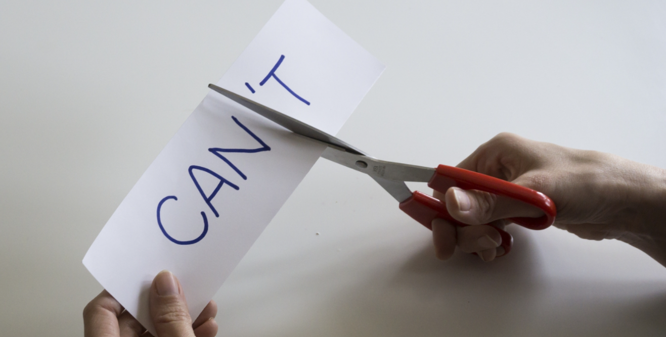

Slide 4
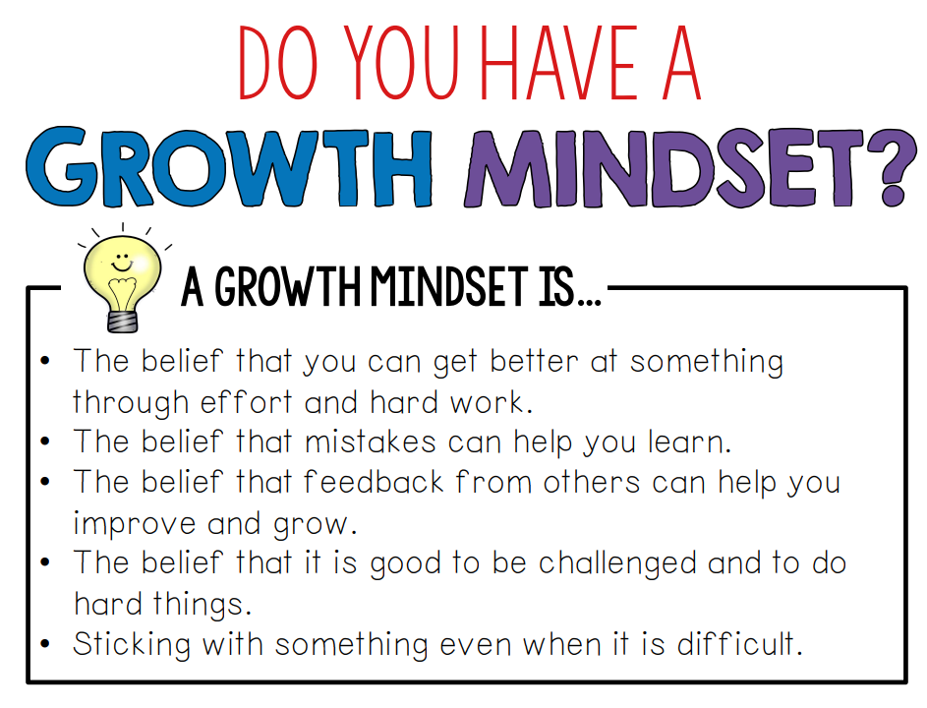

Slide 5
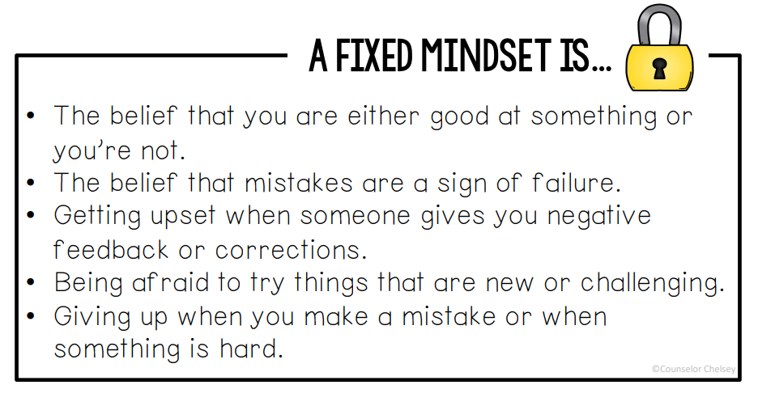

Slide 6
Benefits of Adopting a Growth Mindset
Embrace lifelong learning
Believe intelligence can be improved
Put in more effort to learn
Believe effort leads to mastery
Believe failures are just temporary setbacks
View feedback as a source of information
Willingly embraces challenges
View others’ success as a source of inspiration
View feedback as an opportunity to learn
Reduced burnout
Fewer psychological problems, such as depression and anxiety
Fewer behavioral problems

Slide 7
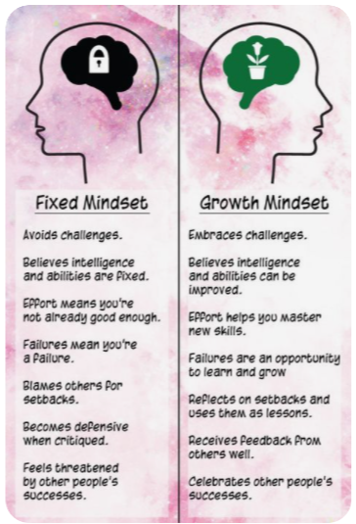

Slide 8
FAMOUS FAILURES
Who was a poor, single mother who suffered from depression, and whose book was rejected 12 times by publishers?
Which famous artist only sold one painting in his/her lifetime, but painted over 900?
Which famous author’s book was rejected between 20-30 times?
Which famous basketball player was cut from his high school basketball team?
Who was part of a girls’ singing group that lost a major singing competition early in her career?
Who was asked to leave his own company before returning and turning it into a household name?

Slide 9
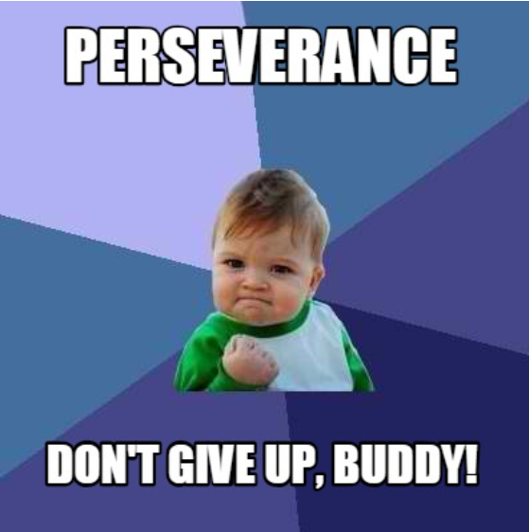
PERSERVERENCE

Slide 10
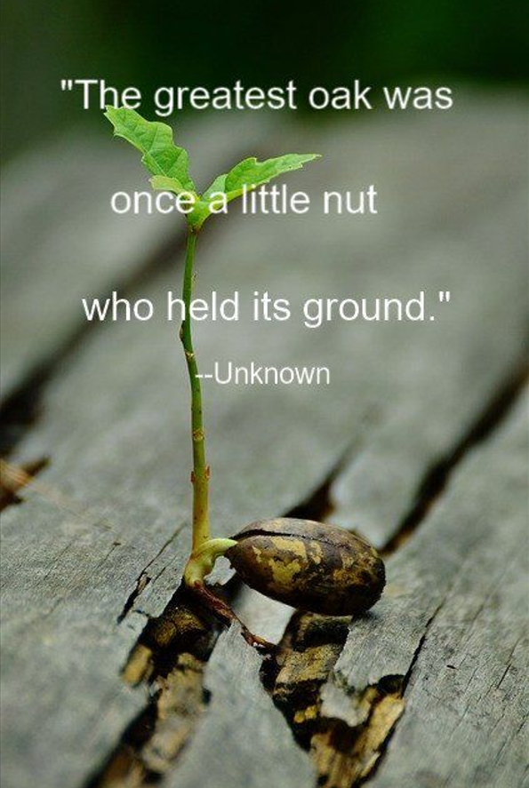

Slide 11
STRATEGIES FOR PRACTICING PERSERVERENCE
Focus on the positive aspects of the situation.
Regulate your emotions.
Monitor your goal progress.
Think of the near finish.
Add a positive activity to make the task more pleasant.

Slide 12
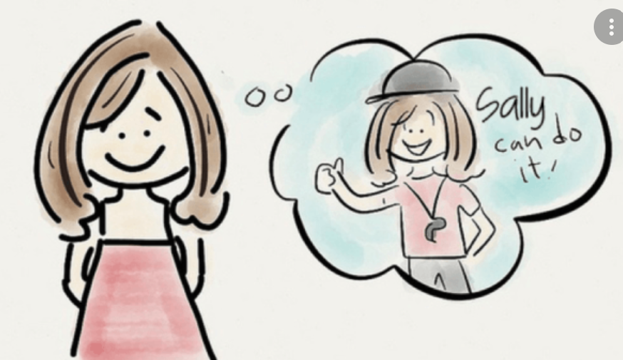
POSITIVE SELF-TALK
Another way of practicing growth mindset and helping ourselves to preservere is to use positive self talk.

Slide 13
Positive Self-Talk
Negative
Positive
I can’t do anything right. Why even try?
I’m good at alot of things. With practice I can get better at this too!

Slide 14
Positive Self-Talk
Negative
Positive
I’ll never get finished with this!
This will take extra time, but I know I can get it done.

Slide 15


Slide 16
